Slide 1

Diabetes
Hypothesis:

Slide 2
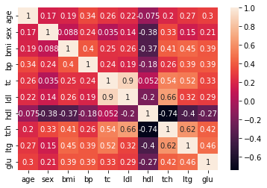

Slide 3
